Slide 1
Budget Buddy
Dynamic computational analysis of transactions in a retail environment
Notes:
Harrison Black

Slide 2
Team Members and Roles
Harrison Black - Mobile App Functionality
Jacob Chaulk - Data Visualization and DB
Jesus Duran - Web App API
Tuan Pham - React Native & Web App UI
Terrell Richardson - Android App UI
Tom Serrano - React Native App
Sixiong Yang - Android App UI
Notes:
Everyone

Slide 3
Functional Requirements
Price input using camera or manual input
Mobile interface with running total
Database for transaction storage
Web application for transaction history
Usable with Android and iOS
Notes:
Harrison Black

Slide 4
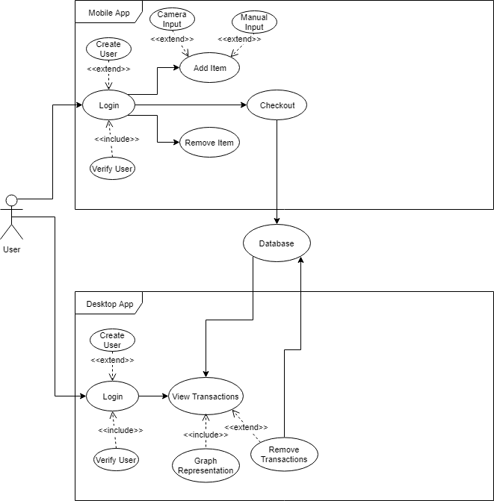
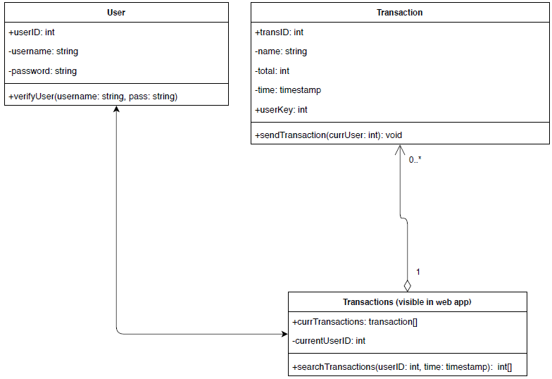
UML Diagrams
Notes:
Jacob Chaulk

Slide 5
Mobile Application Requirements
Registration and login page
Ability to scan prices with the device’s camera using OpenCV and Tesseract OCR libraries
Option to manually input prices
Option to use application offline
Developed for Android and iOS
Notes:
Tom Serrano and David Yang

Slide 6
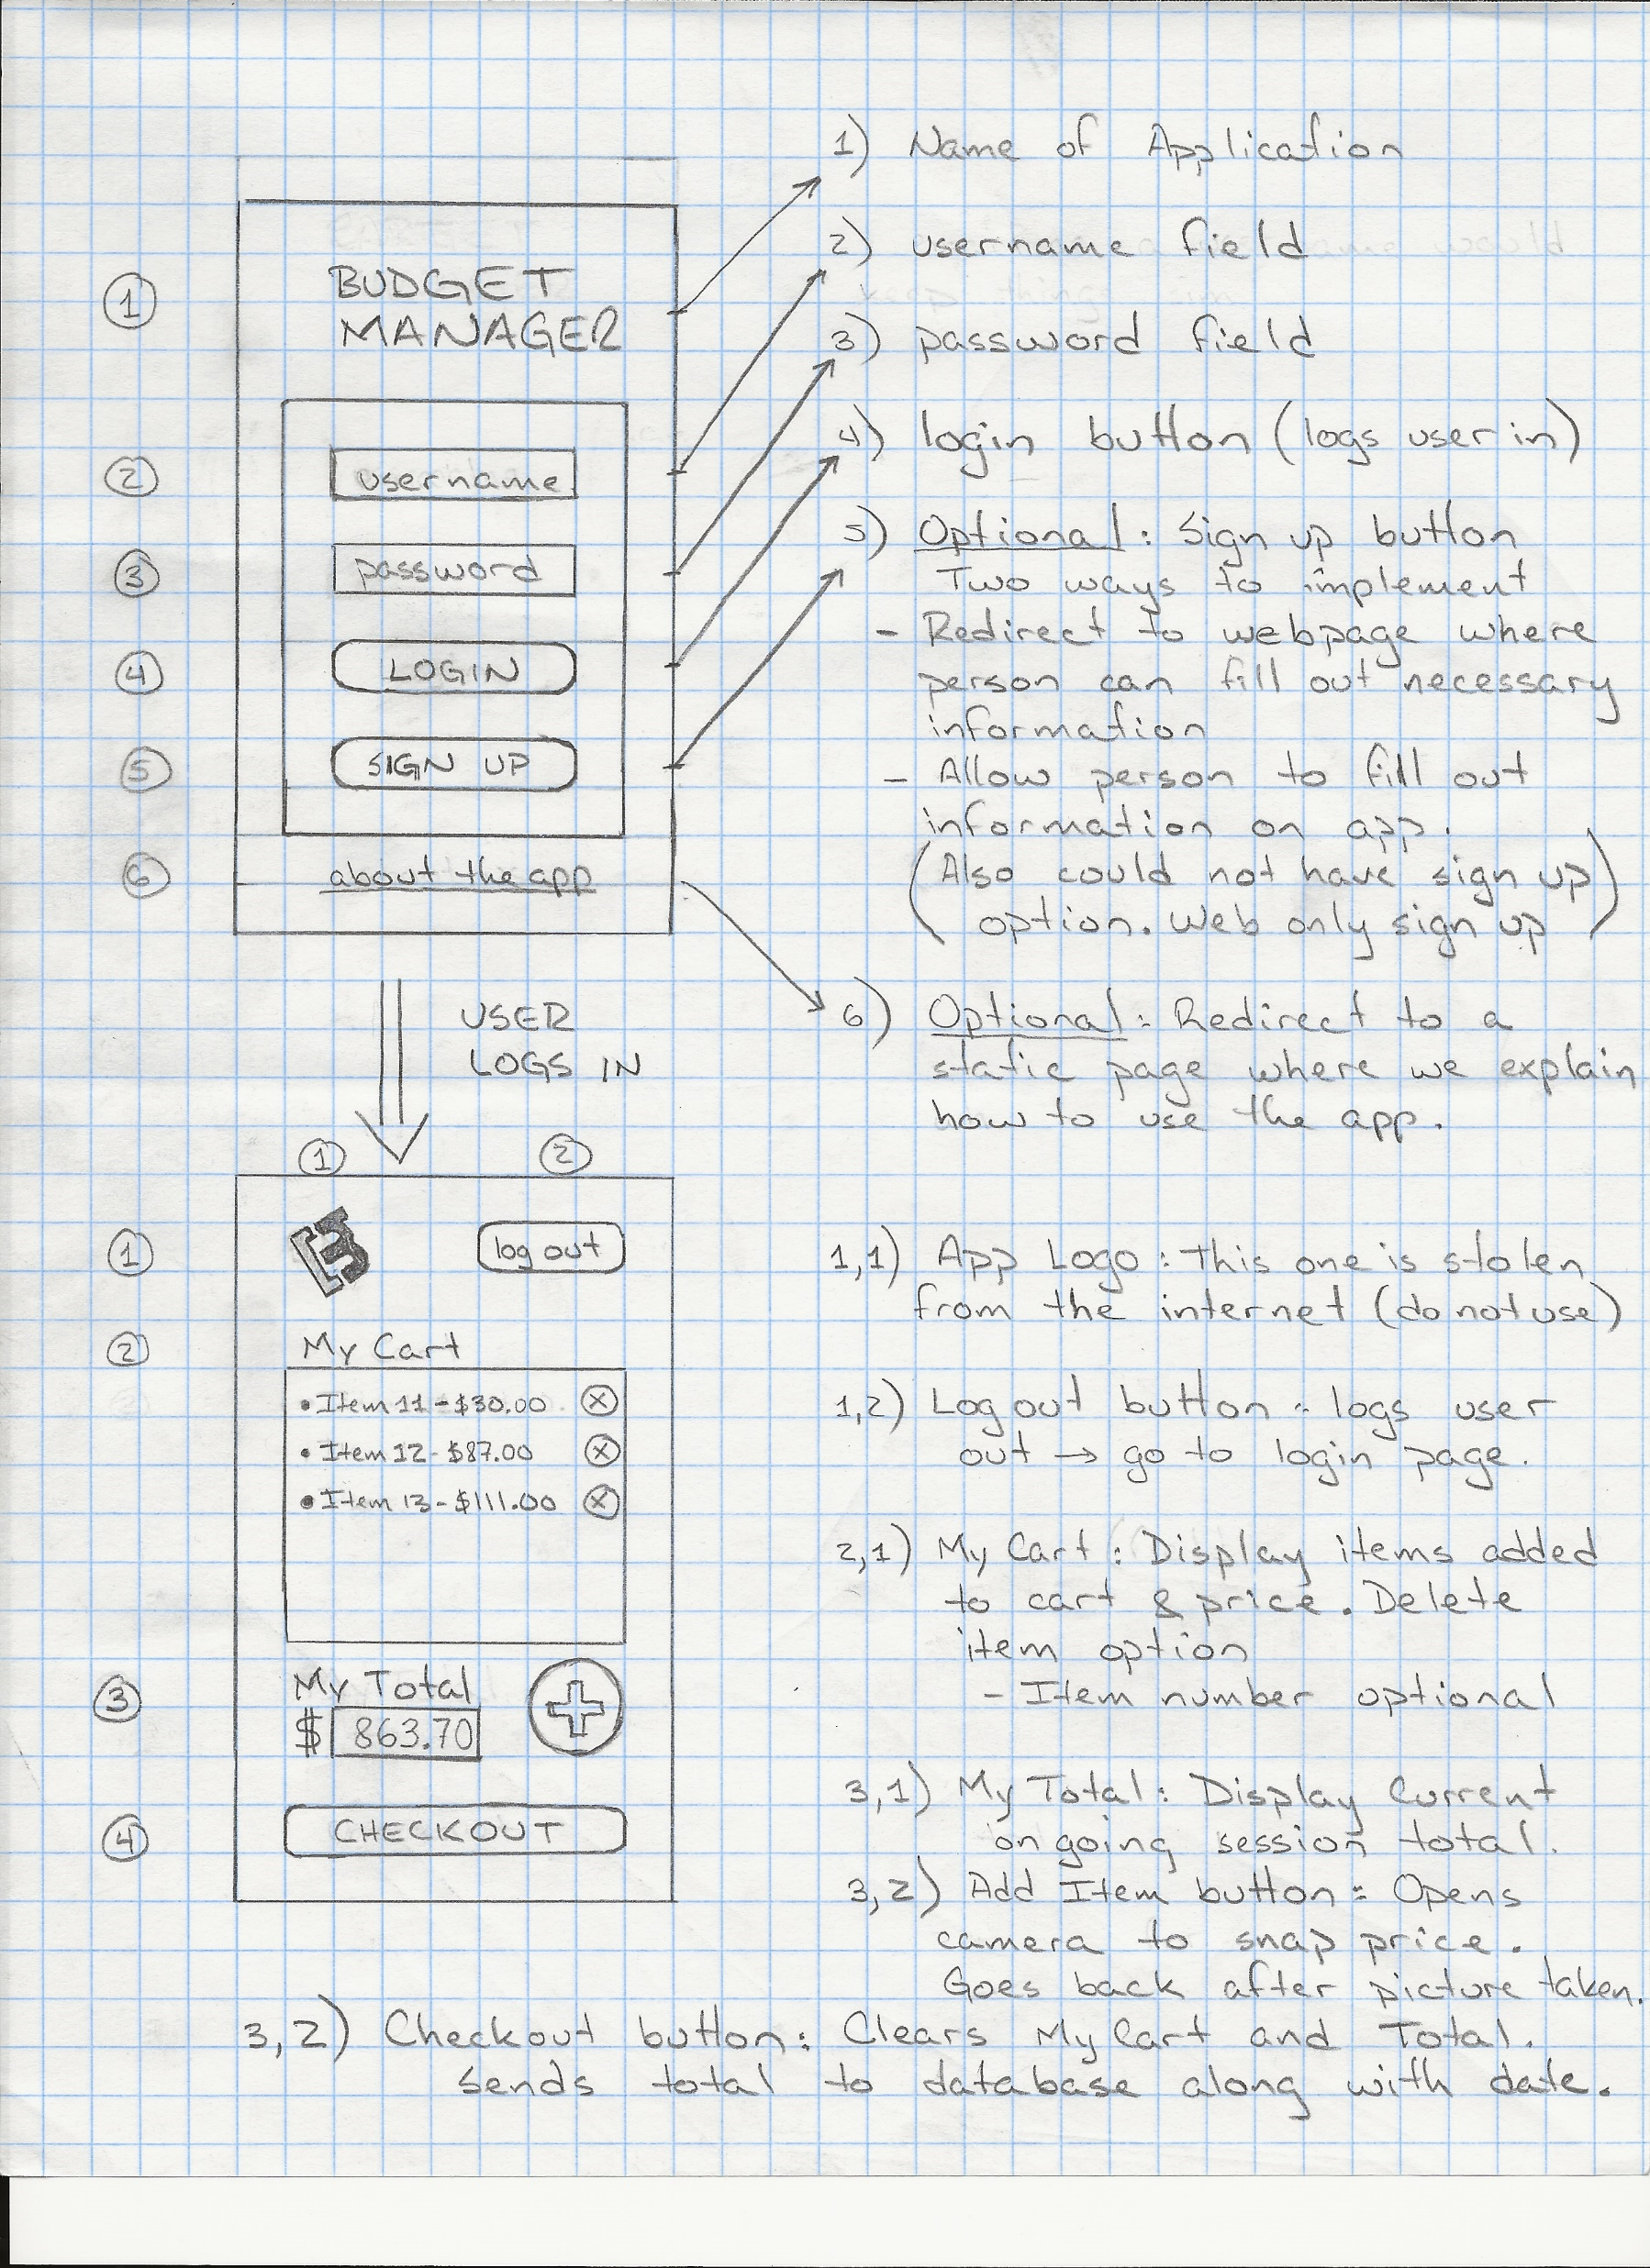
Mobile Mock-up
Notes:
Terrell Richardson

Slide 7
Web Application Requirements
Django Stack
Registration and login page
Display user’s transaction history
Options to display transaction history for various time ranges. E.g. 1 week, 1 month, 1 year
Notes:
Tuan Pham

Slide 8
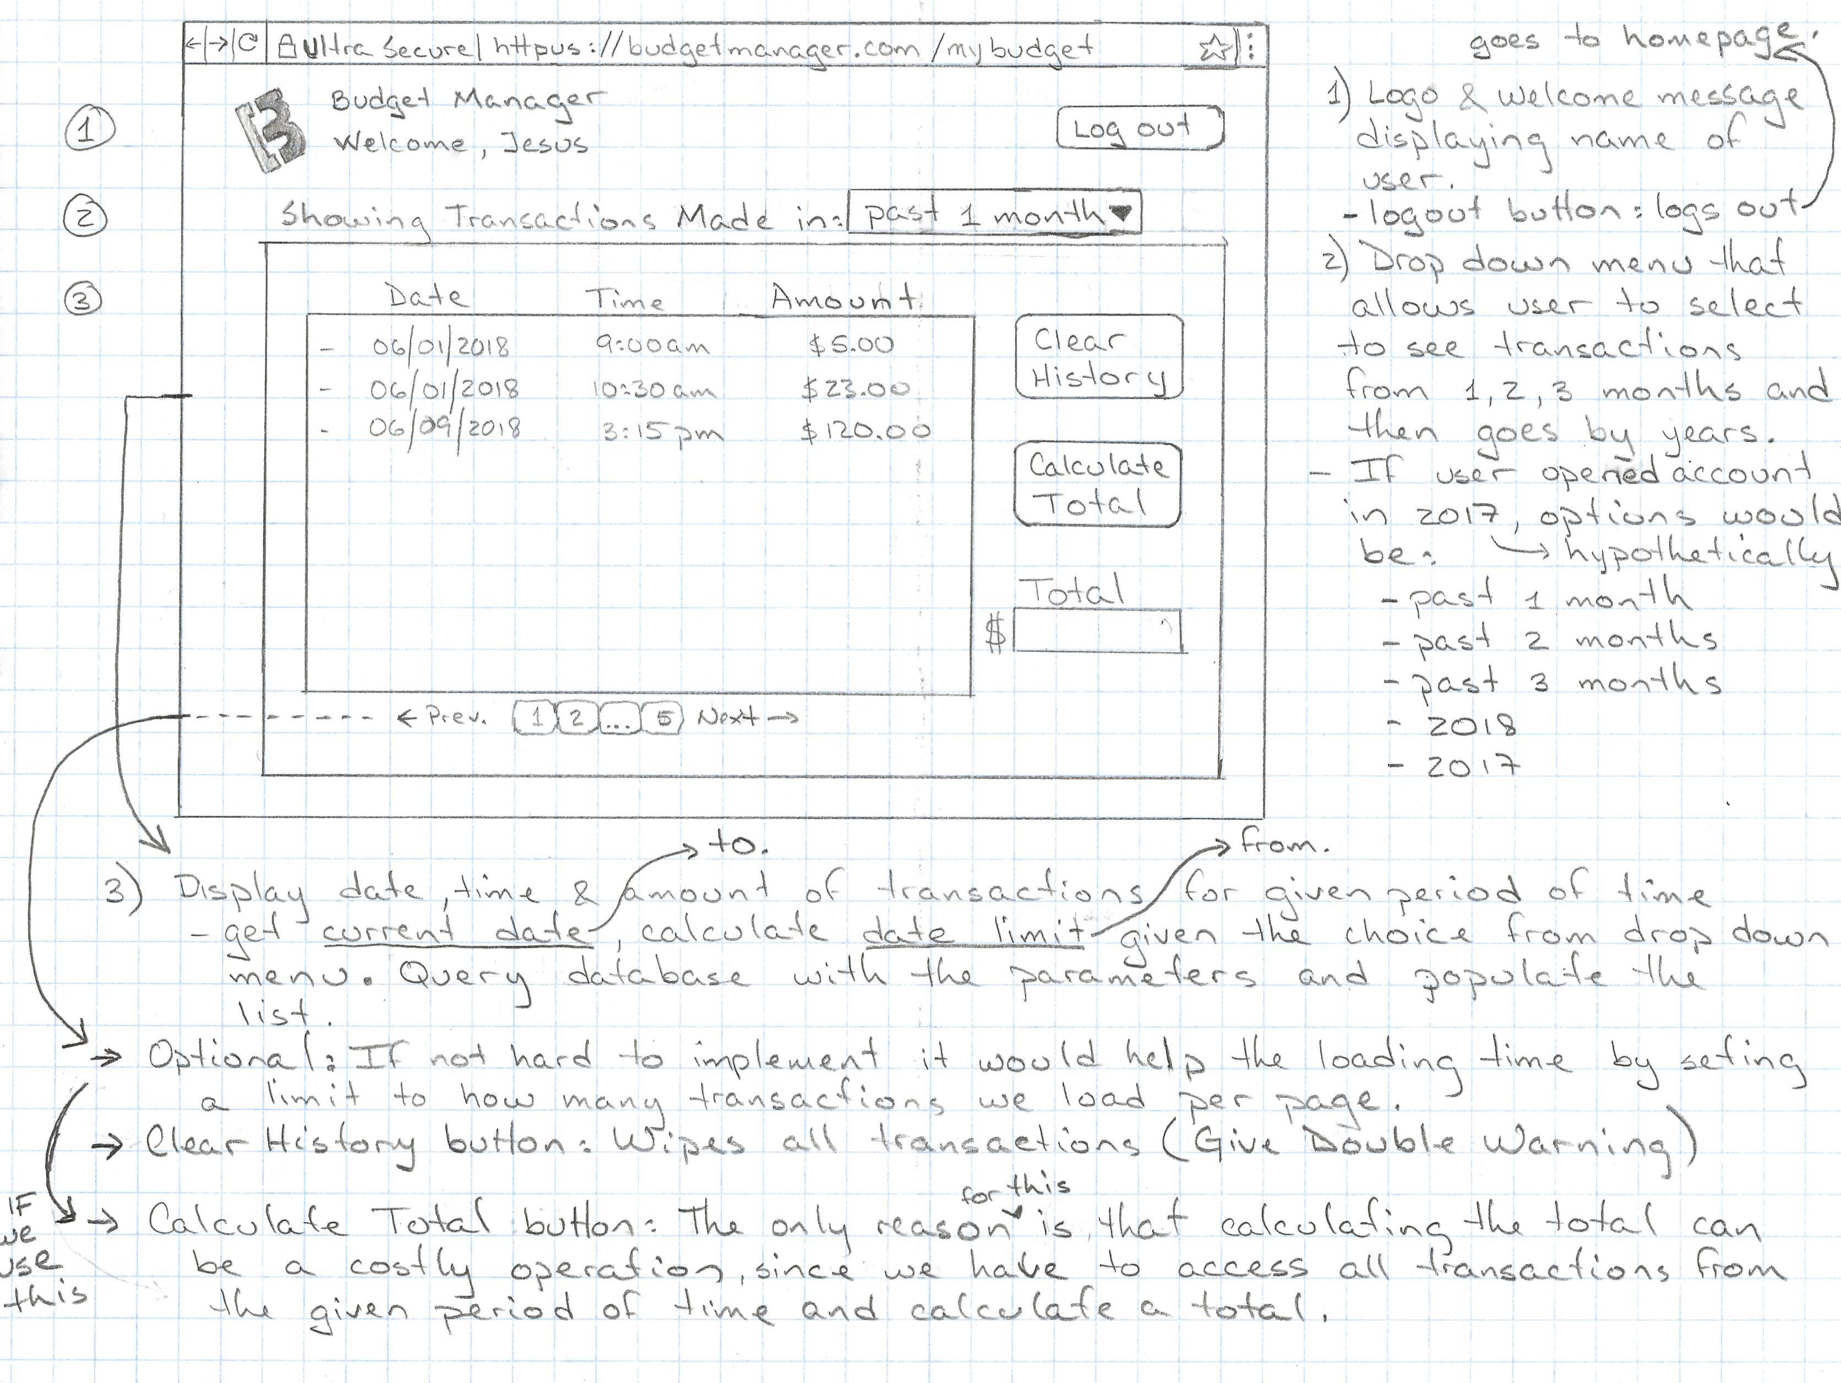
Web Mock-up
Notes:
Jesus Duran

Slide 9
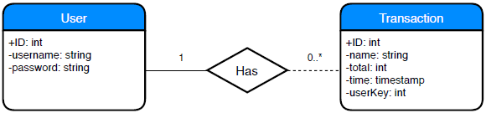
Deployment & Database Services
Deploy both web and mobile applications via Amazon Web Services
Link both applications to the same relational DB

